Slide 1
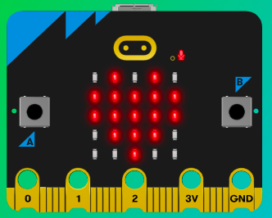
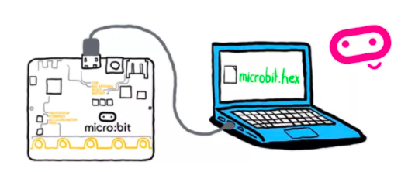
MicroMakers!
KIDS’ MAKER CLUB OF WASHINGTON, DC
Meet Up #7-8

Slide 2
RECAP!
Temperature Sensor
Functions
If, Then, Else
Variable
Loop
Notes:
LEDs, Buttons, Light Sensor

Slide 3
Micro:pet
Let’s Get Making!

Slide 4
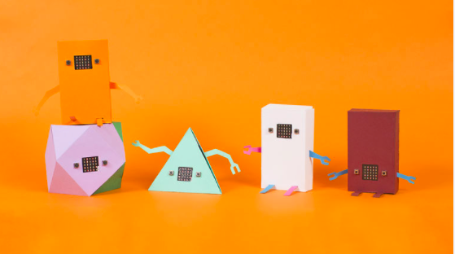
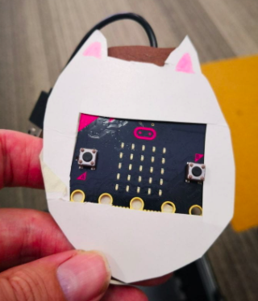
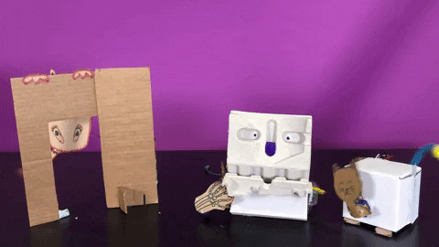
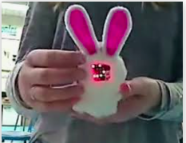
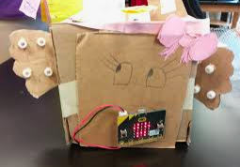
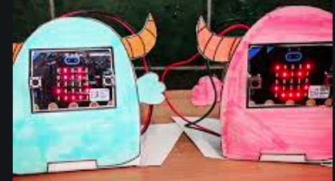

Slide 5
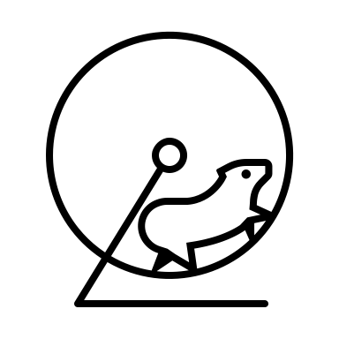
Step 1: The Project Micro:pet
What is it?
Make a cute digital pet that responds to different stimuli.
What do I need?
micro:bit (or MakeCode simulator) with USB
MakeCode or Python editor
Battery pack
A source of heat or cooling, like a fan, if you want to see the temperature change quickly.

Slide 6
Step 2: How Does it Work?
Now it is time to use everything you’ve learned so far about the micro:bit to create your pet! Your pet should do the following:
When you start your micro:bit, your pet should show a sleeping face.
When you pet your pet (touch the micro:bit logo touch sensor), your pet should smile and giggle. After pausing 5 seconds (5,000 miliseconds), they should go back to sleep.
When your pet is turned upside down, they’ll frown and make a sad sound. After five seconds, they should go back to sleep.
When your pet gets too cold or too hot, they should frown and make a sad sound.
When you take your pet for a walk and go more than 20 steps, they should smile and giggle before falling back asleep.
Any other wonderful things you can think of!

Slide 7
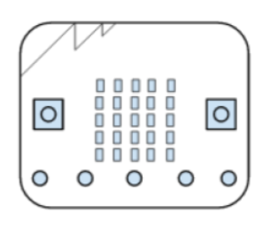
Step 3: (Pseudo) Code It!
When you start your micro:bit, your hamster should show a sleeping face.
On start
Show <sleeping face>

Slide 8
Step 3: (Pseudo) Code It!
When you pet your hamster (touch the micro:bit touch sensor), your pet should smile and giggle. After pausing 5 seconds (5,000 milliseconds), they should go back to sleep.
Input: When logo touched
Output:
Show <smile face>
Play <giggle sound>
Pause <5 seconds or 5,000 milliseconds>
Show <sleeping face>

Slide 9
Step 3: (Pseudo) Code It!
When your pet is upside down, your pet should frown and make a sad sound. After five seconds, they should go back to sleep.
Input: Is upside down
Output:
______________
______________
______________
______________

Slide 10
Step 3: (Pseudo) Code It!
When your hamster gets too cold or too hot, they should frown and make a sad sound.
Forever
Input: Temperature
Output:
If temperature greater than <a number:
then show <sad face> and play <sad sound>
Else if temperature is less than <a number>:
then show <sad face> and play sad sound

Slide 11
Step 3: (Pseudo) Code It!
When you take your pet for a walk and go more than 20 steps, they should smile and giggle before falling back asleep.
On Start
Create variable “steps” and set to zero
Forever
Input: Accelerometer reading
Output:
If accelerometer reading is greater than <a number>:
then add one step to steps variable.
If steps variable is greater than 20:
Show <smile face>
Play <giggle sound>
Pause 5 seconds
Show <sleeping face>

Slide 12
Step 3: (Pseudo) Code It!
When your pet is in the dark, they get scared, and when they are in very, very bright light, they are surprised! What kinds of reactions might your pet make?
Forever
Input: _____________________
Output:
If ______________:
then ____________________
Else if ___________________:
then ____________________

Slide 13
Step 3: Code It!
Before you start coding, plan out what you will do on paper, using the graph paper in your Lab Notes.
Use everything you’ve learned so far. Feel free to refer to old programs in your Lab Notes – that’s what real programmers do!

Slide 14
Step 4: Share Your Creation!

Slide 15
Step 5: Improve It
Make a casing for your pet! Use cardboard, paper, craft supplies – give your get some personality!
Teach your pet to play games, like Magic 8-Ball. Use your imagination!

Slide 16
Compass
a.k.a Magnetometer!

Slide 17


Slide 18
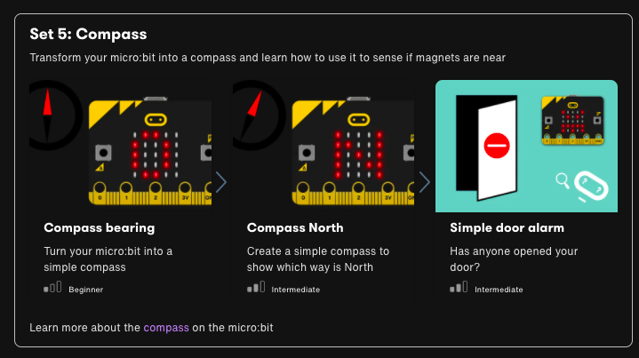

Slide 19
Step 1: The Project The Navigator
What is it?
Turn your micro:bit into a simple compass which shows its bearing from magnetic North in degrees.
What do I need?
micro:bit (or MakeCode simulator) with USB
MakeCode or Python editor
Battery pack (optional)
A planet with magnetic poles to stand on – for example, Earth!

Slide 20
Step 2: How Does it Work?
Your micro:bit has a built-in compass sensor called a magnetometer. You can use it to measure the Earth’s magnetic field and use it as a compass.
When you first use the micro:bit compass you have to calibrate it – a little game appears on the screen where you have to tilt the micro:bit to light up every LED, then you’re ready to go.
When you press the button A input, the micro:bit takes a reading from the compass sensor and shows the device’s numerical compass bearing on the LED display output. Point the micro:bit North and you should see a reading of 0 degrees.

Slide 21
Notes:
Test students on cardinal directions and degrees by moving around the room.

Slide 22
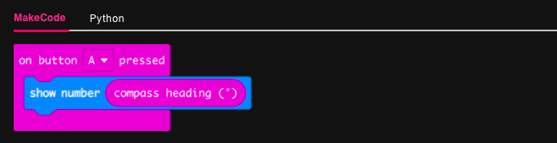
Step 3: Read It and Code It

Slide 23
Step 4: Share Your Creation!

Slide 24
Step 5: Improve It
Add another button to recalibrate the compass.
Have the micro:bit make a sound when it’s pointing in a particular direction – this could be useful to help navigation when you can’t look at a display or for people with impaired vision.
Make the micro:bit display letters or arrows to show if it’s pointing North, South, East or West.

Slide 25
Step 1: The Project Which Way is North?
What is it?
This simple compass will show you which way is North
What do I need?
micro:bit (or MakeCode simulator) with USB
MakeCode or Python editor
Battery pack (optional)
A planet with magnetic poles to stand on – for example, Earth!

Slide 26
Step 2: How Does it Work?
Your micro:bit has a compass sensor called a magnetometer that measures magnetic fields. It can sense the Earth’s magnetic field and so you can use it as a compass.
When you first use the micro:bit compass you have to calibrate it. A little game appears on the screen where you have to tilt the micro:bit to light up every LED, then you’re ready to go.
The program uses an infinite (forever) loop to keep taking compass readings and it stores them in a variable called ‘bearing’. It then uses selection: an if… else statement to show N for North on the LED display if the bearing is greater (>) than 315 degrees or less than (<) 45. This means that it will show you where North is as long as your micro:bit is pointing in roughly the right direction.

Slide 27
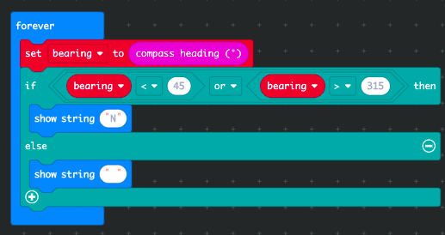
Step 3: Read It and Code It

Slide 28
Step 4: Share Your Creation!

Slide 29
Step 5: Improve It
Make the compass more accurate by reducing the range of bearings: make the number 45 smaller and 315 bigger.
Add other points of the compass to show when the micro:bit is pointing East, West and South.
Add sound so it makes a noise when pointing North so someone who is visually impaired can use the compass.

Slide 30
BREAK!
Dance party!

Slide 31
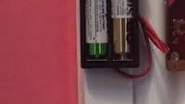
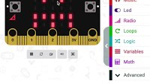
Step 1: The Project Snoop Detector
What is it?
Has anyone been in your room? With a micro:bit, a battery pack and a magnet you can make an alarm to alert you to sneaky snoopers...
What do I need?
micro:bit (or MakeCode simulator) with USB
MakeCode or Python editor
Battery pack (optional)
Magnet
Some way of fixing the magnet, micro:bit and battery pack to the door and door frame

Slide 32
Step 2: How Does it Work?
In this project you'll make a door alarm that works just like a real door sensor in a home security system.
Your micro:bit has a built-in compass sensor called a magnetometer. You can use it to measure the Earth’s magnetic field as a compass - or to sense how strong magnetic fields are much closer to home!
Fix a magnet in the corner of a door and a micro:bit with the door alarm program close to it on the door frame like in the video.
The program uses the micro:bit’s compass (magnetometer) input sensor and a forever loop to keep measuring the strength of the magnetic field.

Slide 33
Step 2: How Does it Work?
It uses selection so when it falls below a certain level (the threshold), it shows an angry face on the LED display. This means the magnet moved away from the micro:bit - when the door was opened - so someone may have been in your room!
Pressing button A shows the current magnetic force reading. Use this to decide what threshold number to use by taking readings with the door open and closed. We used 200 in our example, but this depends on how strong your magnet is and if there are any other magnetic fields nearby. The coding video above shows you how to do this.
Press button A to clear the angry face and reset the alarm.
Note that when you first use the compass sensor you may have to calibrate it by playing a game to fill the screen with dots, like calibrating a mobile phone’s compass.

Slide 34
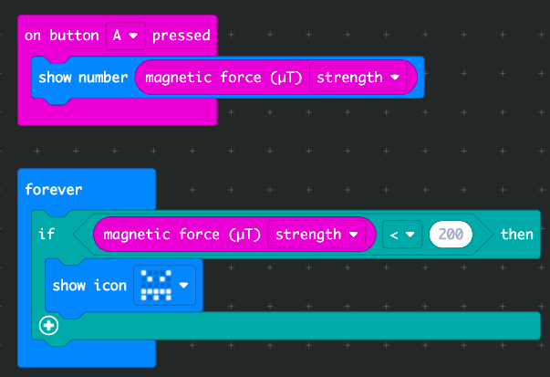
Step 3: Read It and Code It

Slide 35
Step 4: Share Your Creation!

Slide 36
Step 5: Improve It
Use a variable to count the number of times your door has been opened - you'll need to add code to sense when it's been opened and closed
Advanced: Create a timer to measure how long a door has been left open

Slide 37
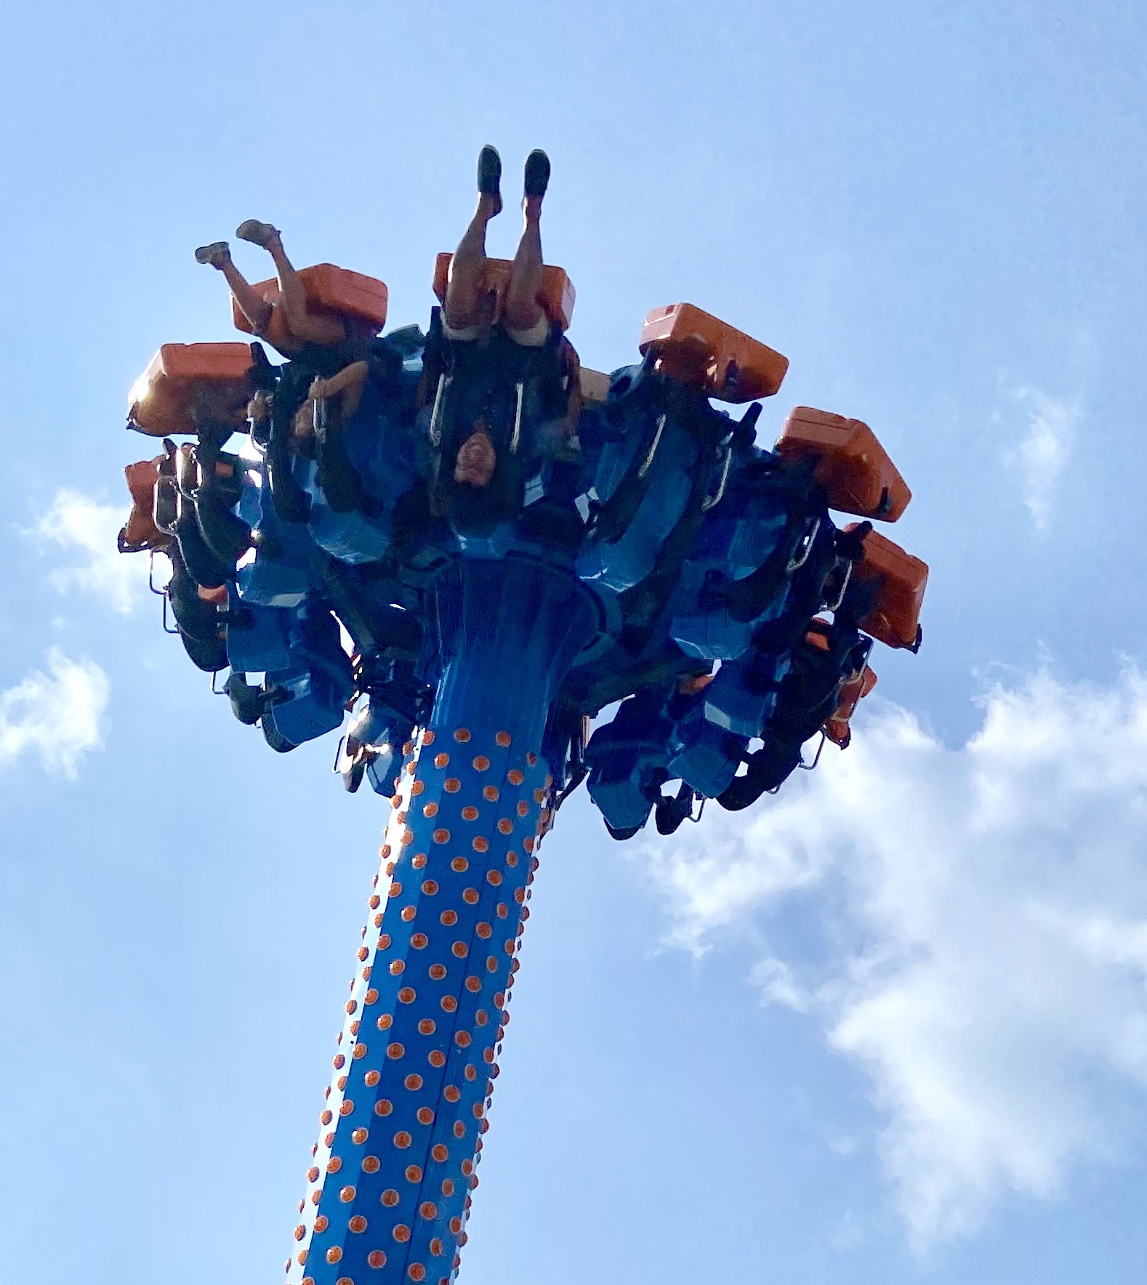
SKILL BADGE
Make a sibling snooper detector
YOUR MISSION
Use a variable to count the number of times your door has been opened - you'll need to add code to sense when it's been opened and closed.
Step 1: Write Pseudo Code
Step 2: Write Code and Test with Simulator
Step 3: Debug
Step 4: Download onto Micro:bit and Test

Slide 38
SKILL BADGE
Treasure Hunt!
YOUR MISSION
Make a treasure hunt game that utilizes the step counter and compass!
Step 1: Write Pseudo Code
Step 2: Write Code and Test with Simulator
Step 3: Debug
Step 4: Download onto Micro:bit and Test

Slide 39
TIME TO PUT AWAY OUR MICRO:BITS!
Neat and tidy, please!
Let’s leave this beautiful room as lovely as we found it!

Slide 40
NEXT TIME
Radio!

Slide 41
RADIO Projects!
Oh boy, here we go!
Use radio to make a remote sensor sending temperature readings to another micro:bit, for example from outside to inside. You could make an indoor / outdoor thermometer this way.
Make a radio-controlled remote alarm so when you know someone’s turned the lights on – or opened a drawer or bag, and/or when someone has opened the door to your room.
ULTIMATE TREASURE HUNT GAME

Slide 42
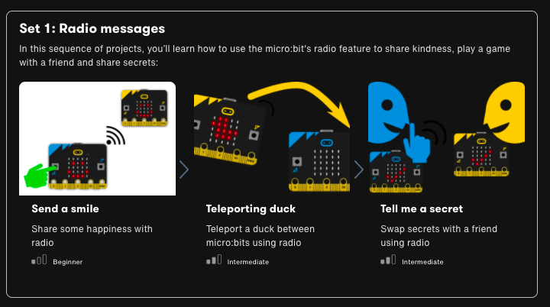

Slide 43

UNTIL NEXT TIME….
MicroMakers!
Slides and Script: Holly Krambeck (learningpython64@gmail.com)
Project Videos, Images, and Text: https://microbit.org/get-started

